Slide 1

LARC
Quality Improvement Collaborative
Introductory Webinar:
Overview of LARC
Need-to-Know Information to Prepare for LARC
LARC
Barbara C McKinney, MD, MPH
Katy Yao, PhD
10 October 2019

Slide 2
Introductory Webinar
For TODAY
OVERVIEW / SENSITIZATION
LARC Collaborative Overview Why? What? When? Quality Improvement Guiding Principles Model for Improvement DMAIC Metrics/Measurement
IN-COUNTRY PREPARATION
Preparation for the LARC Initiative & Smart Start LARC Capability Maturity Model (CMM)
Sensitization
/ Overview
In-country Preparation

Slide 3
WHY
Notes:
Why does quality matter?

Slide 4
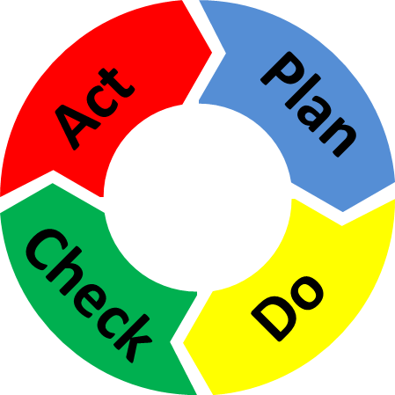
Quality Improvement is about CHANGE!
Old Process
Tests of CHANGE
Sustain the New CHANGE
Implement the New CHANGE
Notes:
The skeleton of the Quality Improvement process…

Slide 5
The great aim of education is not knowledge, but action!
Herbert Spencer

Slide 6
Purpose/Expectations:
To create an improvement culture where team members understand and utilize practical QI tools:
to successfully complete a QI project
and
to make CQI the way teams work for the future!

Slide 7

Embed Improvement in your DNA

Slide 8
LARC = Measurable RESULTS
LARC 1.0 - Results from 6 Countries (2016-2017)
LARC 2.0 - Results from Sites in Kenya (2018-2019)
Notes:
WHY – Because LARC is proven to be effective in creating improvement!

Slide 9






To increase the percentage of viral load samples collected from eligible patients from 45% (Jul 2016) to 80% by Aug 2017
To increase the percentage of viral load tests ordered for eligible patients from 0% (July 2016) to 80% by June 2017 in CPN, CCR, and ARV clinics
To increase the percentage of patients with viral load results placed in their files from 4% (October 2016) to 80% by June 2017
Mozambique
Malawi
Kenya
LARC Project
spread to
all Clinic
Clinician Education
All Clinic
Clinic Director Follow-up
Clinician Education began
Nationwide HCW strike
To increase the percentage of high viral load patients with documented timely follow-up from 12% (average from Dec’15 to June ‘16) to 80% by June 2017
To increase the percentage of high VL patients with a documented return visit from 35% (Oct 2016) to 100% by June 2017
To increase the percentage of high VL patients 1) contacted ≤ 1 week after results receipt from 27% to 90%, and 2) initiated with IAC ≤ 1 month from 6% to 90% between June 2016 and June 2017
Swaziland
Tanzania
Uganda
Baseline
HVL register implemented
IAC forms implemented
HVL stickers on patient files

Slide 10
Riruta Health Centre
To reduce the number of missed appointments due for viral load test from 25% to 10% by March 2019
Embakasi Health Centre
To reduce % of missing viral load results in the viral load tracking log from 2% to 0% by March 2019
Thika L5 Hospital
To increase % of hardcopy viral load results placed in patient files from 0 % to 90% by March 2019
Due to result delays, 100% results were missing in last 2 periods (not shown here)
Delay of results due to reagent shortage
Maragua Sub County Hospital
To increase the % of HVL results documented in the green cards in patients’ files from 23% to 80% by March 2019
Baraka Dispensary
To decrease % of patients with HVL not attending EAC within 30 days of receiving results from 48% to 10% by March 2019
LARC 2.0

Slide 11
WHAT
Notes:
Next, let’s discuss WHAT… WHAT is LARC…

Slide 12
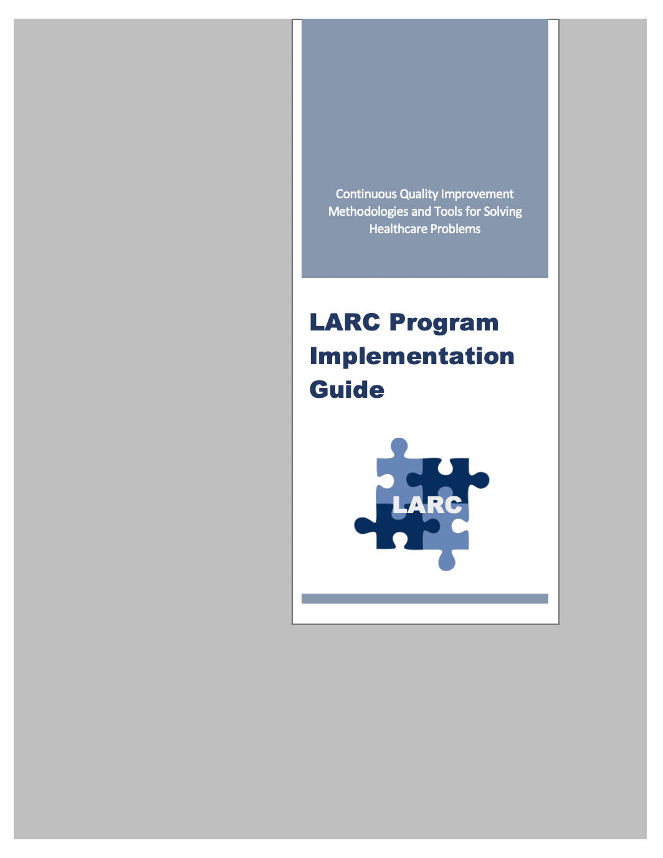
Frequently Asked Questions (FAQs)
What is LARC?
Learning Collaborative Initiative → Improvement
  To achieve better patient/client care, to improve measurable results, through a multidisciplinary, CQI approach
  To advance and embed institutional improvement capacity and effectiveness
larccqi.org

Slide 13
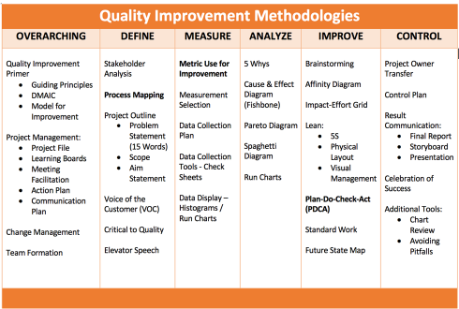
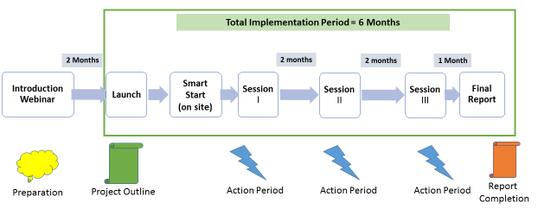
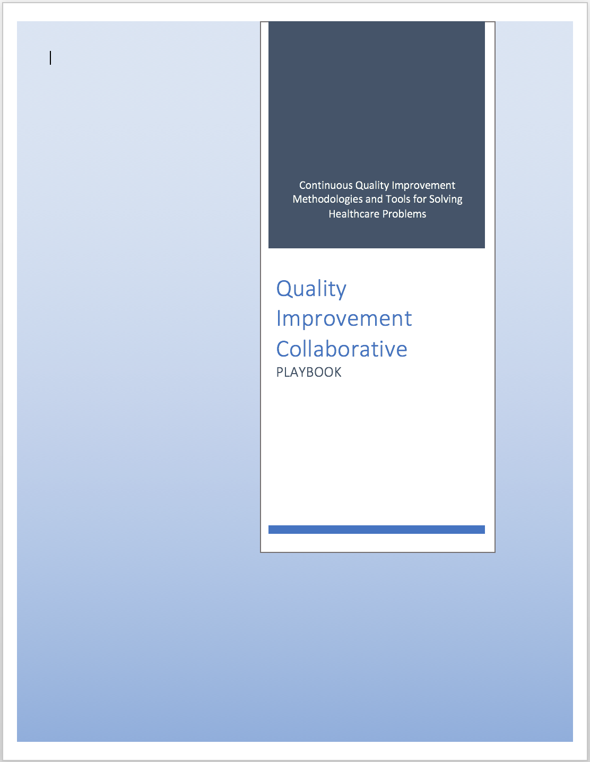
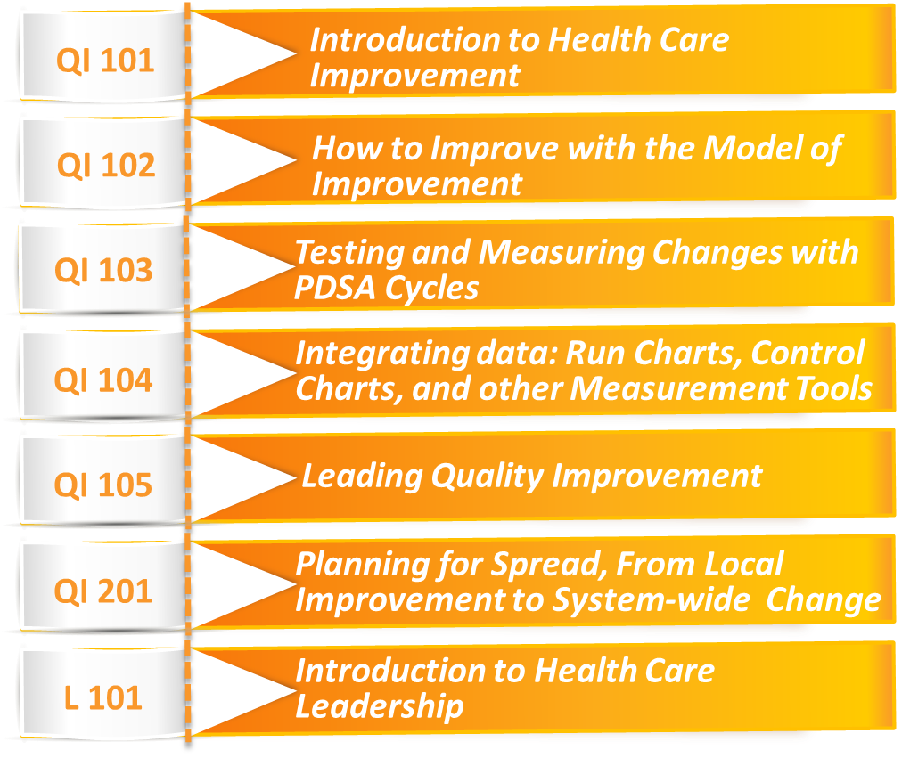
Curriculum + Delivery Model = Results
Curriculum
Delivery Model
QI Concepts/Skills
IHI Open School
Workbook
QI Tools
Notes:
LARC – 2 components
The educational content, - material, tools, concepts, skills = the curriculum – includes the content – delivered by PPT, and the Playbook – the resource for tools
The model of delivery - # of sessions, timing of sessions, action periods – all = The Delivery Model

Slide 14
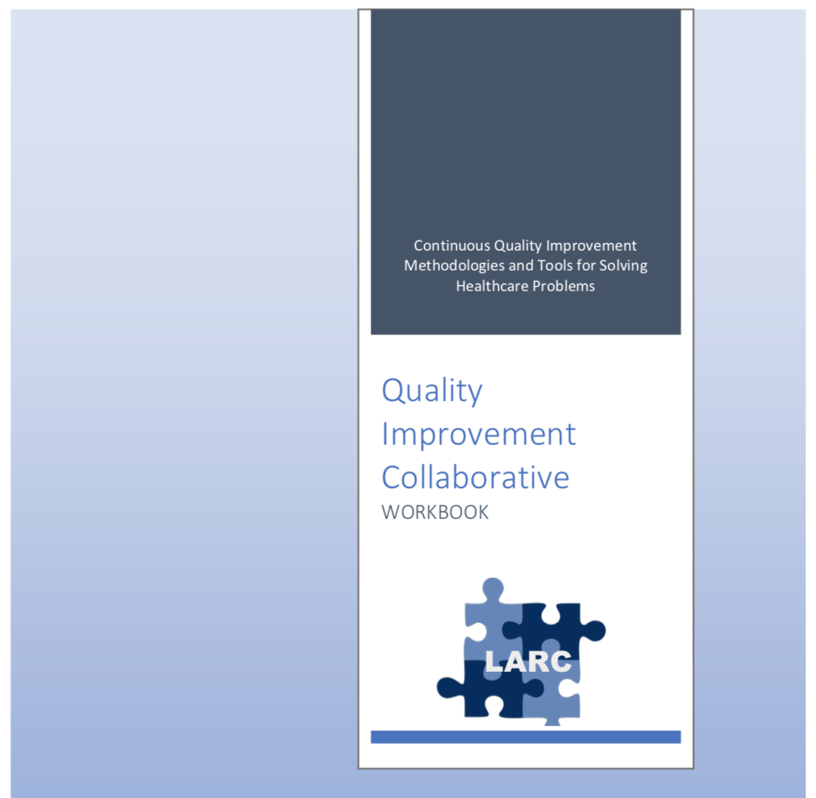
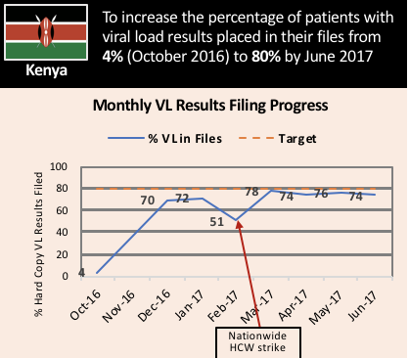
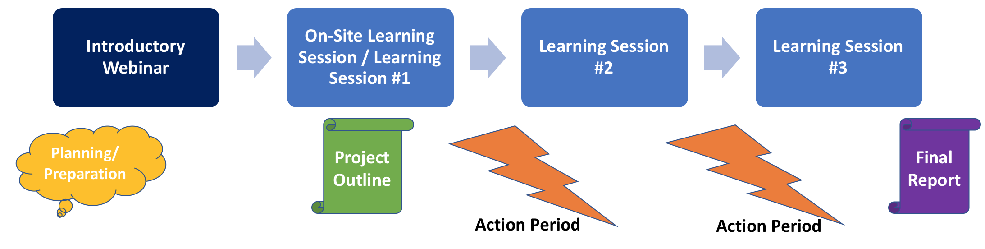
What is LARC?
African Regional Improvement Collaborative focused on the Laboratory-Clinic Interface
LARC
Bringing together multidisciplinary clinical teams to improve any process or system
CURRICULUM: Quality Improvement (QI) Methodologies |  | DELIVERY MODEL: Learning Collaborative |  | OUTCOME
Focused on QI concepts, skills, tools & implementation 30+ QI Tools Coordinated step-by-step guidance through project Just-in-time training to produce QI project deliverables |  | Learning Sessions Delivered over 3-18 months Action Periods Mentoring & Coaching Site Visits Learning shared among collaborative members |  | Improved Healthcare Delivery – Safer, higher-quality, client-centered Successfully Completed Project/s - Result-driven Embedded QI Concepts & Skills → Culture of Improvement

Slide 15
LARC =
African Regional Improvement Collaborative
LARC
Bringing together the laboratory and clinical cadres to implement and scale up HIV viral load testing
Demand Creation for Testing
Specimen Collection and Processing
Sample Transport
Laboratory Testing
Result Reporting
Patient Management
Viral Load Cascade
Lab-Clinic Interface
Lab-Clinic Interface

Slide 16
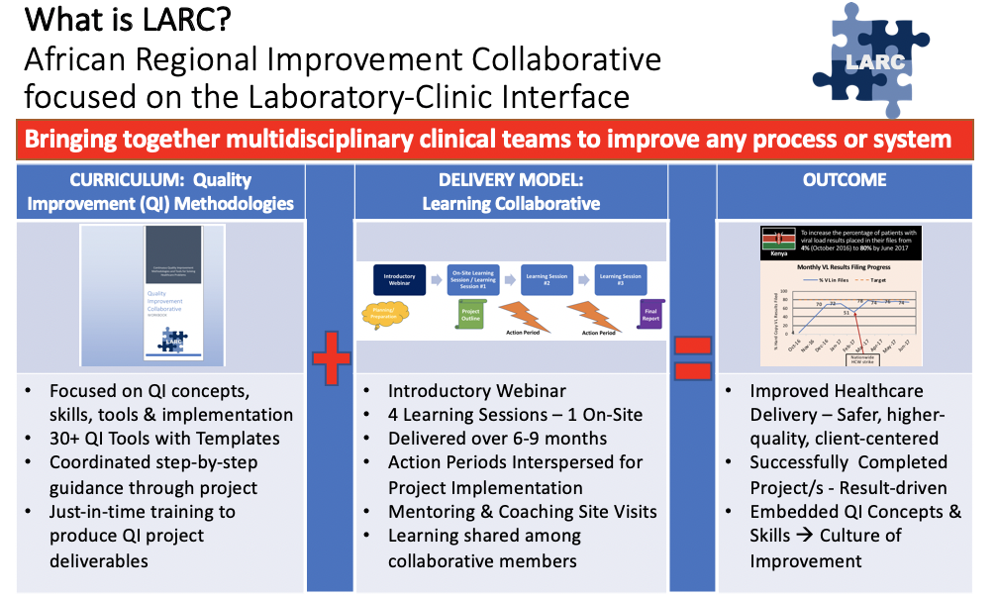
STOP & SUMMARIZE
WHAT
WHY

Slide 17
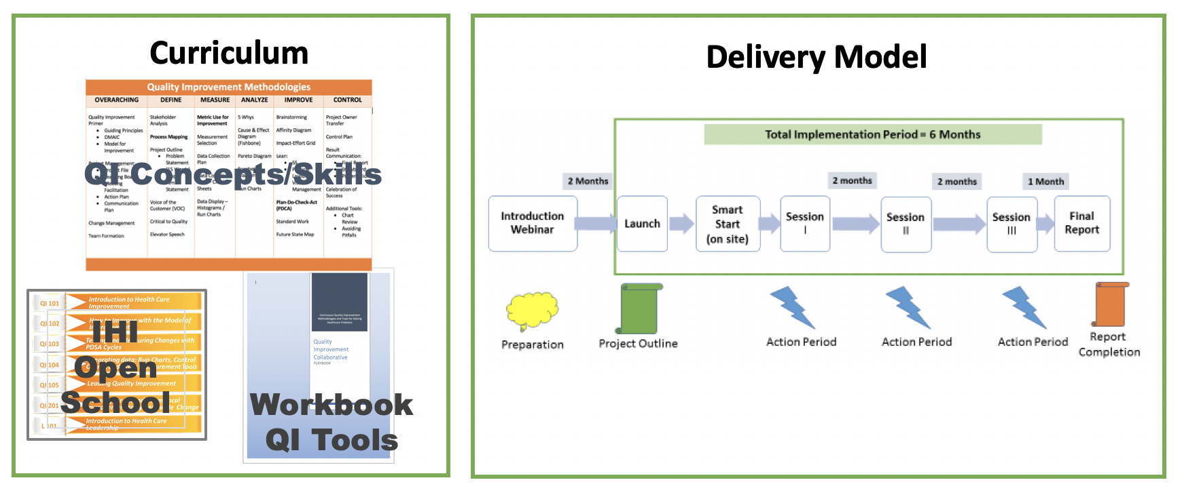
Curriculum + Delivery Model = Results

Slide 18
Curriculum
Prerequisites
Deliverable-focused
CONTENT (PowerPoint)
WORKBOOK (Resource)
Notes:
The curriculum is the educational content of the program – the concepts, tools, skills, etc.
We will cover these 4 elements of the Curriculum next.

Slide 19
Prerequisites*
Assuring a standardized QI Knowledge
Prerequisites – Seven (7) Mandatory Courses
For Country Leads, Coaches & Team Members
Improvement Capability
QI 101: Introduction to Health Care Improvement (1hr:15 min) QI 102: How to Improve with the Model of Improvement (1hr:30 min) QI 103: Testing and Measuring Changes with PDSA Cycles (1hr:15 min) QI 104: Integrating data: Run Charts, Control Charts, and other Measurement Tools (1hr:30 min) QI 105: Leading Quality Improvement (1hr:15 min) QI 201: Planning for Spread, From Local Improvement to System-wide Change (1hr:15 min)
Leadership
L 101: Introduction to Health Care Leadership (1hr:15 min)
* From the Institute for Healthcare Improvement (IHI) Open School - http://www.ihi.org
Notes:
Important implications for in-country LARC leads, faculty, and site mentors

Slide 20
Project Deliverables
DELIVERABLE-FOCUSED
Smart Start & Session 1
Define/Measure/Analyze
Learning Session 2
Improve
Learning Session 3
Control
Stakeholder analysis Team formation tools Process mapping (current) Project Outline Brainstorming and Impact-effort grid Baseline Metrics - Data Collection Tool/Plan Action Plan Elevator Speech Voice of the customer Analyze tools (5 whys, etc.) The Model for Improvement - PDSA Presentation at the next learning session | Project Outline (refined) 5S Visual Management The Model for Improvement - PDSA Run charts Process mapping (future state) Standard Work Presentation at the next learning session | Project Outline (refined) Control Plan Result communication Final Presentation

Slide 21

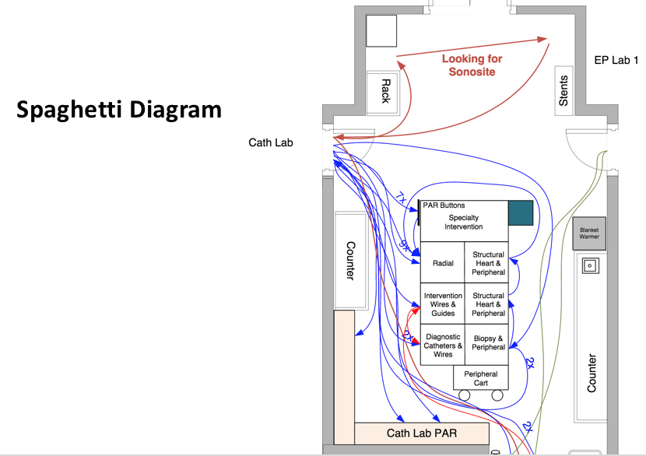
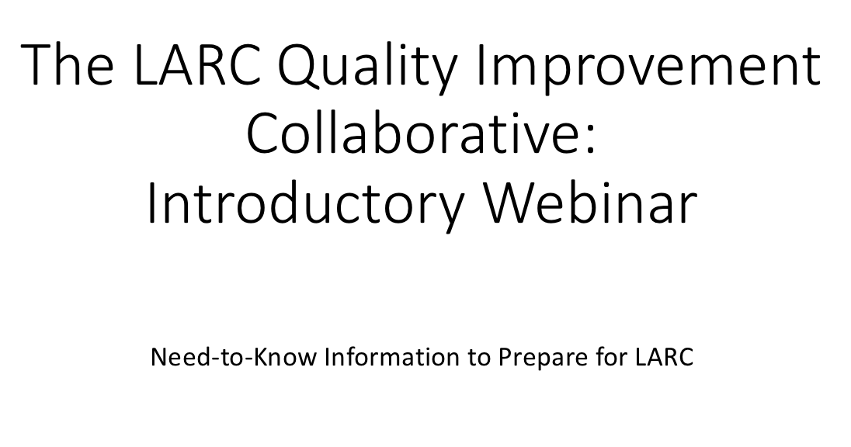

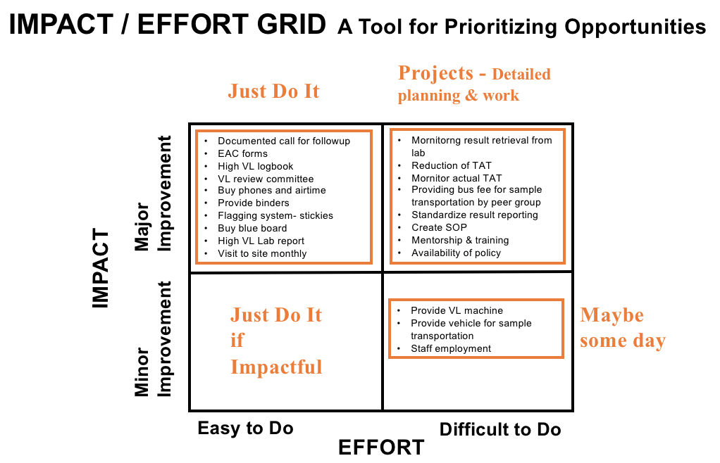
CONTENT: QI Concepts, Tools & Skills (PowerPoint) Presented in Learning Sessions
PowerPoint Presentations

Slide 22
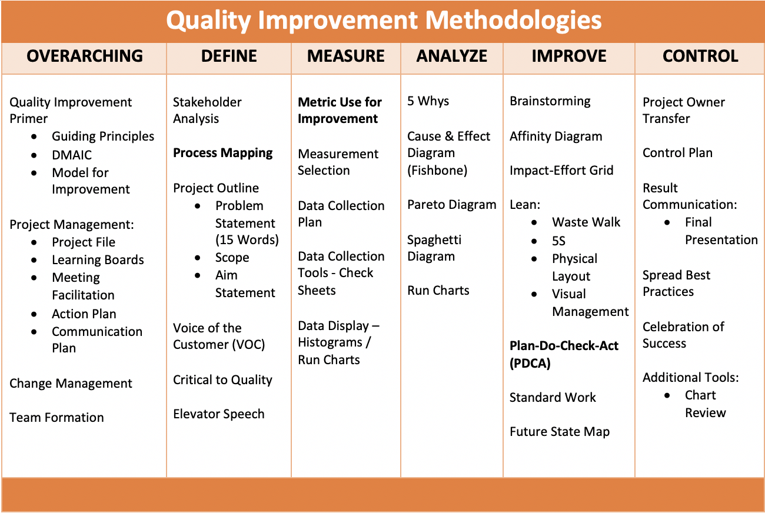
30+ Quality Improvement Tools
TOOL-BASED
WORKBOOK
Notes:
The curriculum is based on over 30 proven QI tools (Details not important – just to see the number of tools)
LARC 2.0 - New Tools Added – Change Management, Voice of the Customer, Etc.
Enhanced practical training on the use of each tool

Slide 23
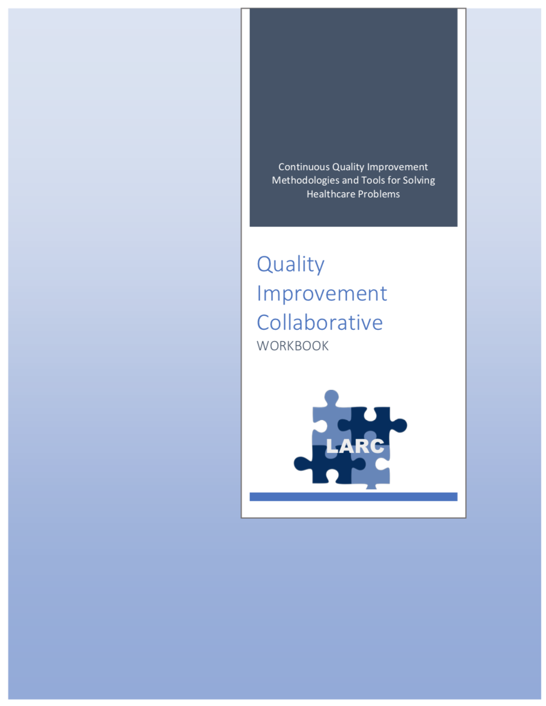
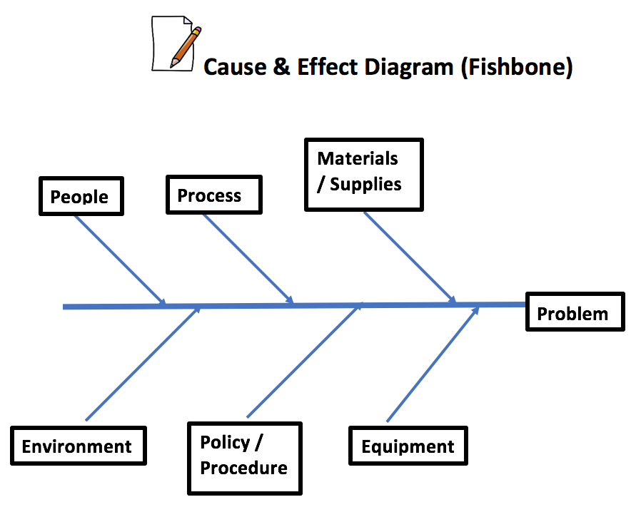
WORKBOOK
QI TOOL RESOURCE
30+ Tools in 80+ pages
Notes:
Leave behind resource with all the tools & templates

Slide 24
Delivery Model
Pre-training Preparation – Introductory Webinar
On-Site Smart Start Session
Learning Sessions
Accountability/Follow-Up
Notes:
Let’s look at the following 4 aspects of the way that the LARC curriculum will be delivered

Slide 25
Quality Improvement Collaborative Overview: Program Delivery
2 Months
2 months
2 months
1 Month
Introductory Webinar
Launch
Smart Start
(on site)
Session I
Session II
Session III
Final Report
Action Period
Action Period
Action Period
Introductory Webinar – Stakeholder sensitization and project planning
Smart Start – 2-day facility-based process mapping and development of project outline, done at each site

Slide 26

Introductory Webinar
Conducted prior to the first Smart Start Session to:
Sensitize & engage stakeholders
Orient teams
Complete planning and preparation to ensure readiness before Smart Start & Learning Sessions
Target Audience:
In country leadership
Ministry of Health
Implementing Partners
Faculty/coaches
Facility teams
Notes:
2 New sessions:
The introductory webinar is for the in-country leadership, faculty, site mentors, coaches & team leaders.
Key purposes:
Sensitization
Identifying & engaging stakeholders
Selecting & engaging team
Assuring planning & preparation complete prior to the first Smart Start Session – Essential to the success of this new model

Slide 27
Smart Start: 2-Day On-Site Session
Expected Outcomes:
Process mapping
Opportunities for Improvement (OFI)
Project Outline:
  Project scope
  Problem Statement
  Aim statement
  Measures and data collection plan/tools
Action and communication plans
Purpose:
To set the site up for successful project implementation
To standardize mentorship practice by different coaches across all project sites
Notes:
The Smart Start Session – NEW Session
Purpose:
To clearly understand the problem through process mapping
To provide direction to start the improvement work – quicker, faster, smarter
A critical new session to get the project off to a productive start – On-site coaching of the team in process mapping and project implementation

Slide 28

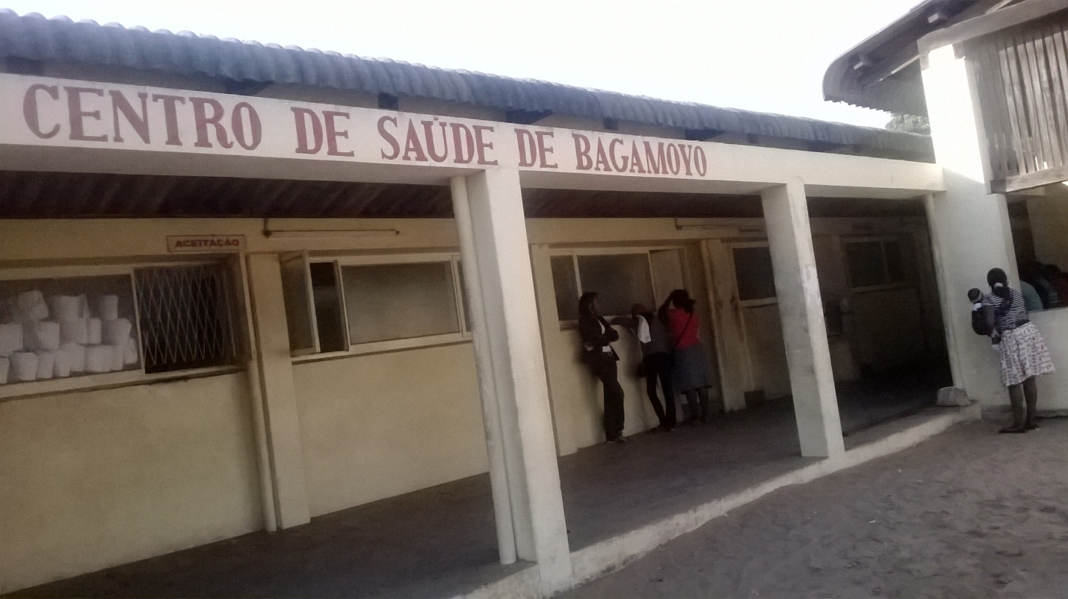

Smart Start
Day #1 | Day #2
Orientation Process Mapping Current State (Conference Room) | Identify / Prioritize Opportunities For Improvement (OFI) Problem Statement
Process Mapping @ Site - Go and See | Project Implementation – Outline & Action Plan Project Communication
Notes:
Conducted in several of the countries for LARC 1.0

Slide 29
SESSION | Introductory Webinar | Smart Start: 2-Day On-Site | Learning Session #1 | Learning Session #2 | Learning Session #3
CONTENT | Quality Improvement Primer - Guiding Principles DMAIC Model for Improvement Data/ Measurement Overview Stakeholder Analysis Team Formation Planning for Smart Start / Process Mapping | DEFINE / MEASURE Process Mapping Brainstorming / Affinity Diagram Prioritize Opportunities for Improvement (OFIs) Impact/Effort Grid Project Outline Problem Statement Scope Aim Statement / Metric Elevator Speech Action Plan Communication Plan | Quality Improvement Review Smart Start Outputs PDCA Overview Project Mgmt. Change Mgmt. Voice of Customer Critical to Quality Data/Measurement ANALYZE 5 Whys, Cause & Effect Diagram, Pareto Diagram, Spaghetti Diagram, Run Charts/Control Charts | IMPROVE Simulation Before/After PDCA / Small Test of Change Lean 5S Visual Management Physical Layout Standardized Work Future State Process Map Data Display | CONTROL Process Owner Transfer Control Plan Result Communication Final Report Storyboard Presentation Spread Best Practices Celebrate Success Additional Tools Chart Review Avoiding Pitfalls

Slide 30
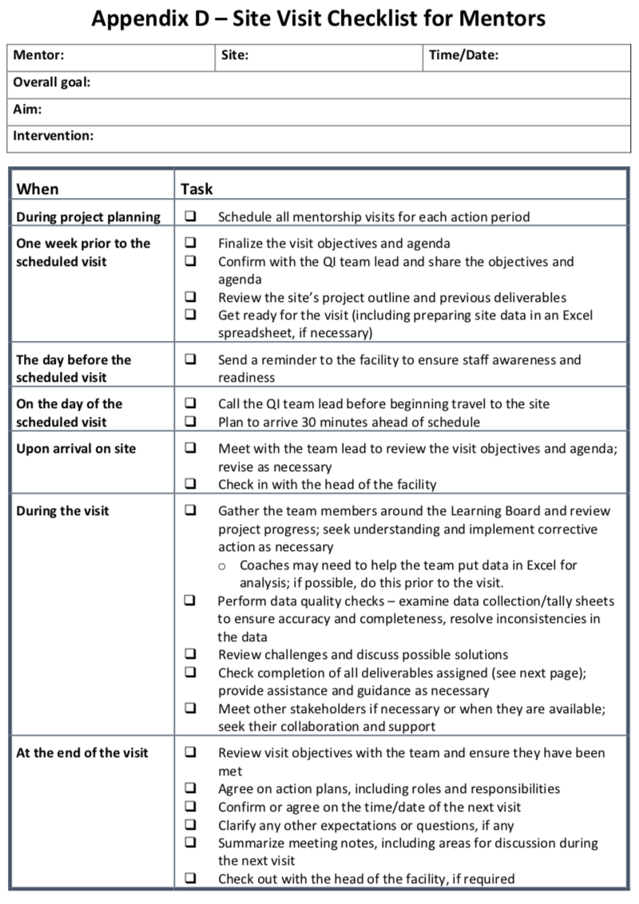
After each training session:
Accountability and Follow-Up
Site Visit Checklist
Focus on Project Follow-up
Site Visits
Phone Calls
Mentoring
Coaching
Notes:
Assuring that there is ACTION in the Action Periods

Slide 31
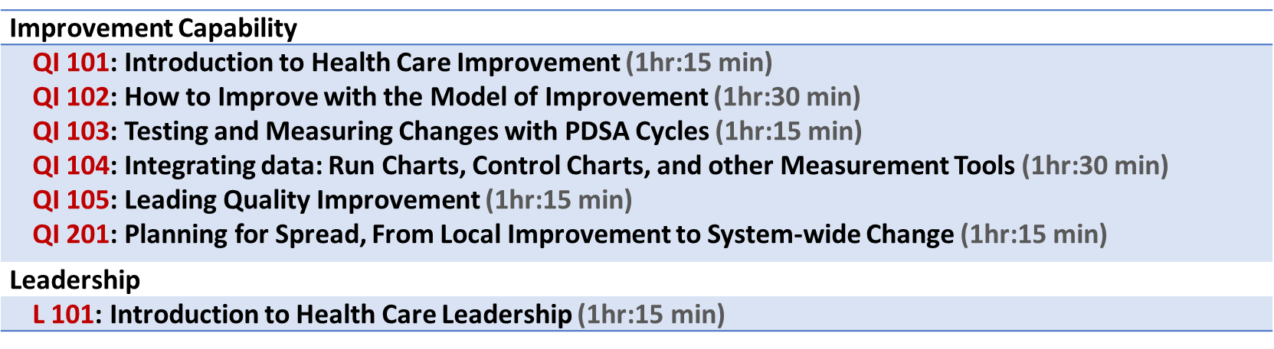
Plan for Spread from the Very Beginning
IHI Open School Course
Learn the Improvement Methodologies
Start Small – Small tests of change
Select changes that result in improvement
Implement changes that result in improvement
Plan for Implementation at Scale
Notes:
Just a reminder for the countries – start small and plan for spread from the beginning
Encourage the country LARC leaders to take the IHI course early – while ”piloting” LARC 2.0 so they will be ready for spread when the “pilot” is complete

Slide 32
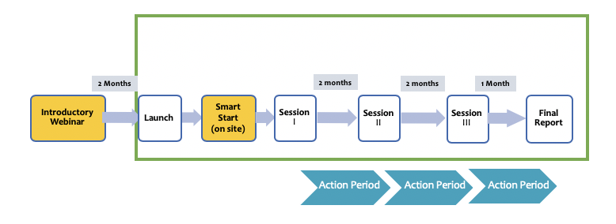
STOP & SUMMARIZE

Slide 33
Quality Improvement
Change/Model for Improvement
DMAIC
Guiding Principles

Slide 34
Quality Improvement is about CHANGE!
Old Process
Tests of CHANGE
Sustain the New CHANGE
Implement the New CHANGE
Notes:
The skeleton of the Quality Improvement process…

Slide 35
Quality Improvement Overview:
DMAIC Approach
Old Process
Tests of CHANGE
Implement the New CHANGE
Sustain the New CHANGE
Define
Measure
Analyze
Improve
Control

Slide 36
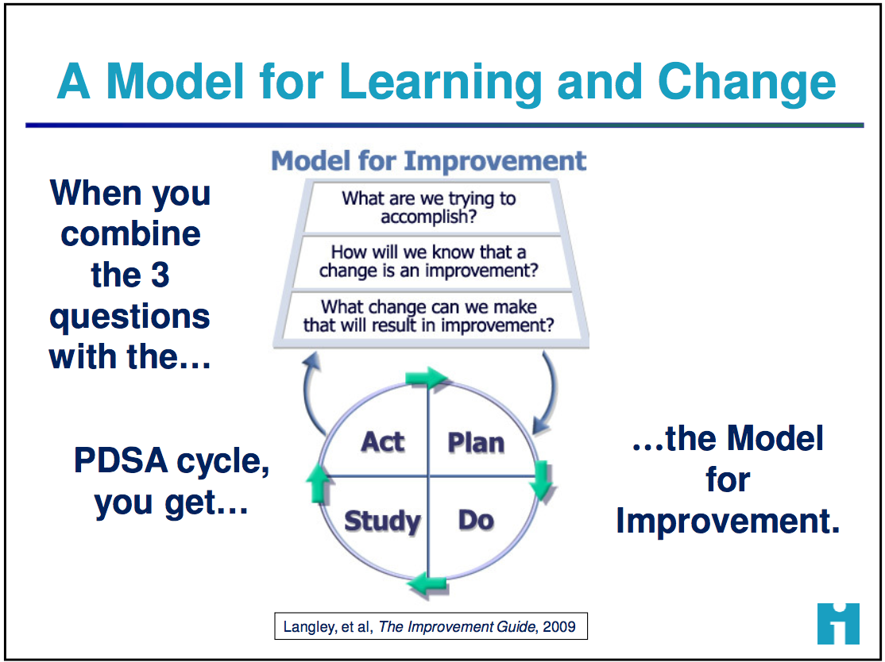
How do we create change?
3 Questions + PDCA = The Model for Improvement

Slide 37
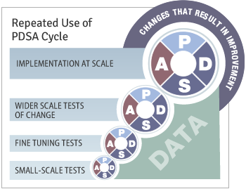
Quality Improvement
Overview
Old Process
Tests of CHANGE
Implement the New CHANGE
Sustain the New CHANGE
Define
Measure
Analyze
Improve
Control

Slide 38
Guiding Principles for Quality Improvement
Focus on the needs of the USERS
Focus on PROCESSES to increase the productivity of work
Use DATA to improve services
Use TEAMS to improve quality
Improve COMMUNICATION
Gilbert Burnham, MD, PhD

Slide 39
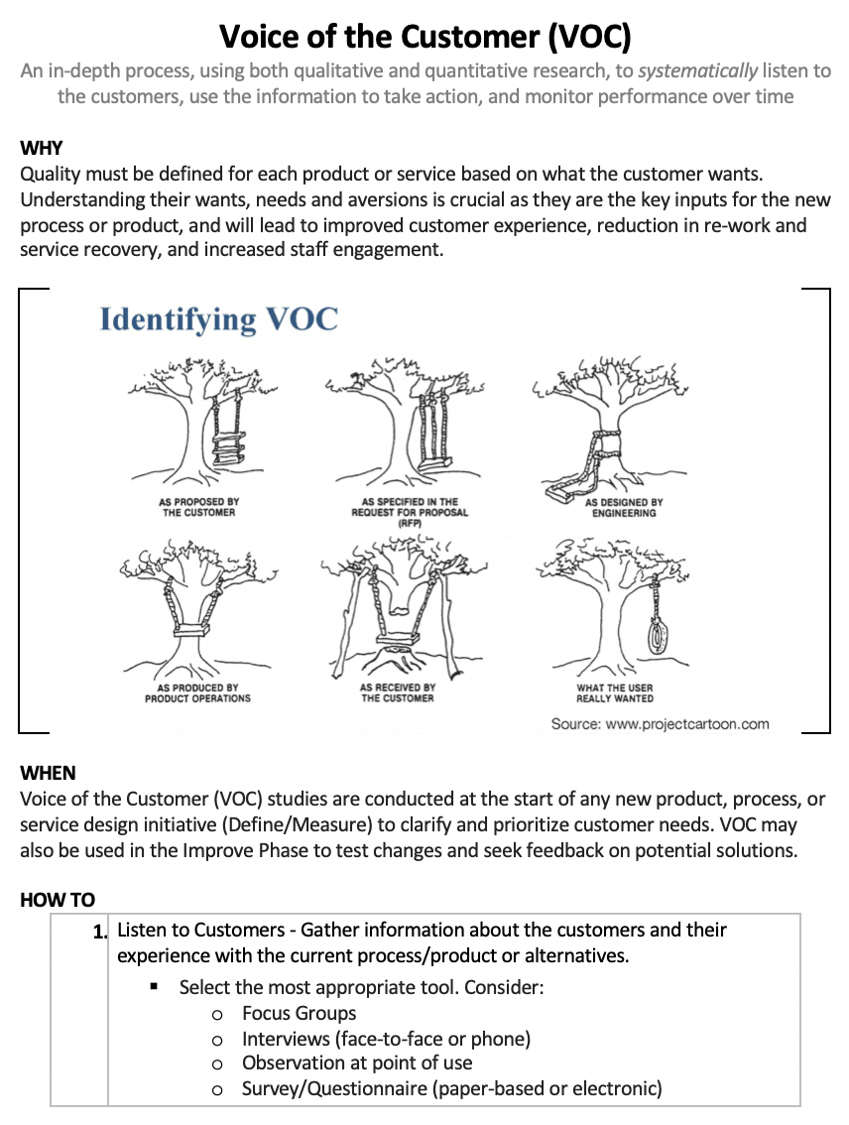
Focus on the…
Needs of the USER
VOC

Slide 40
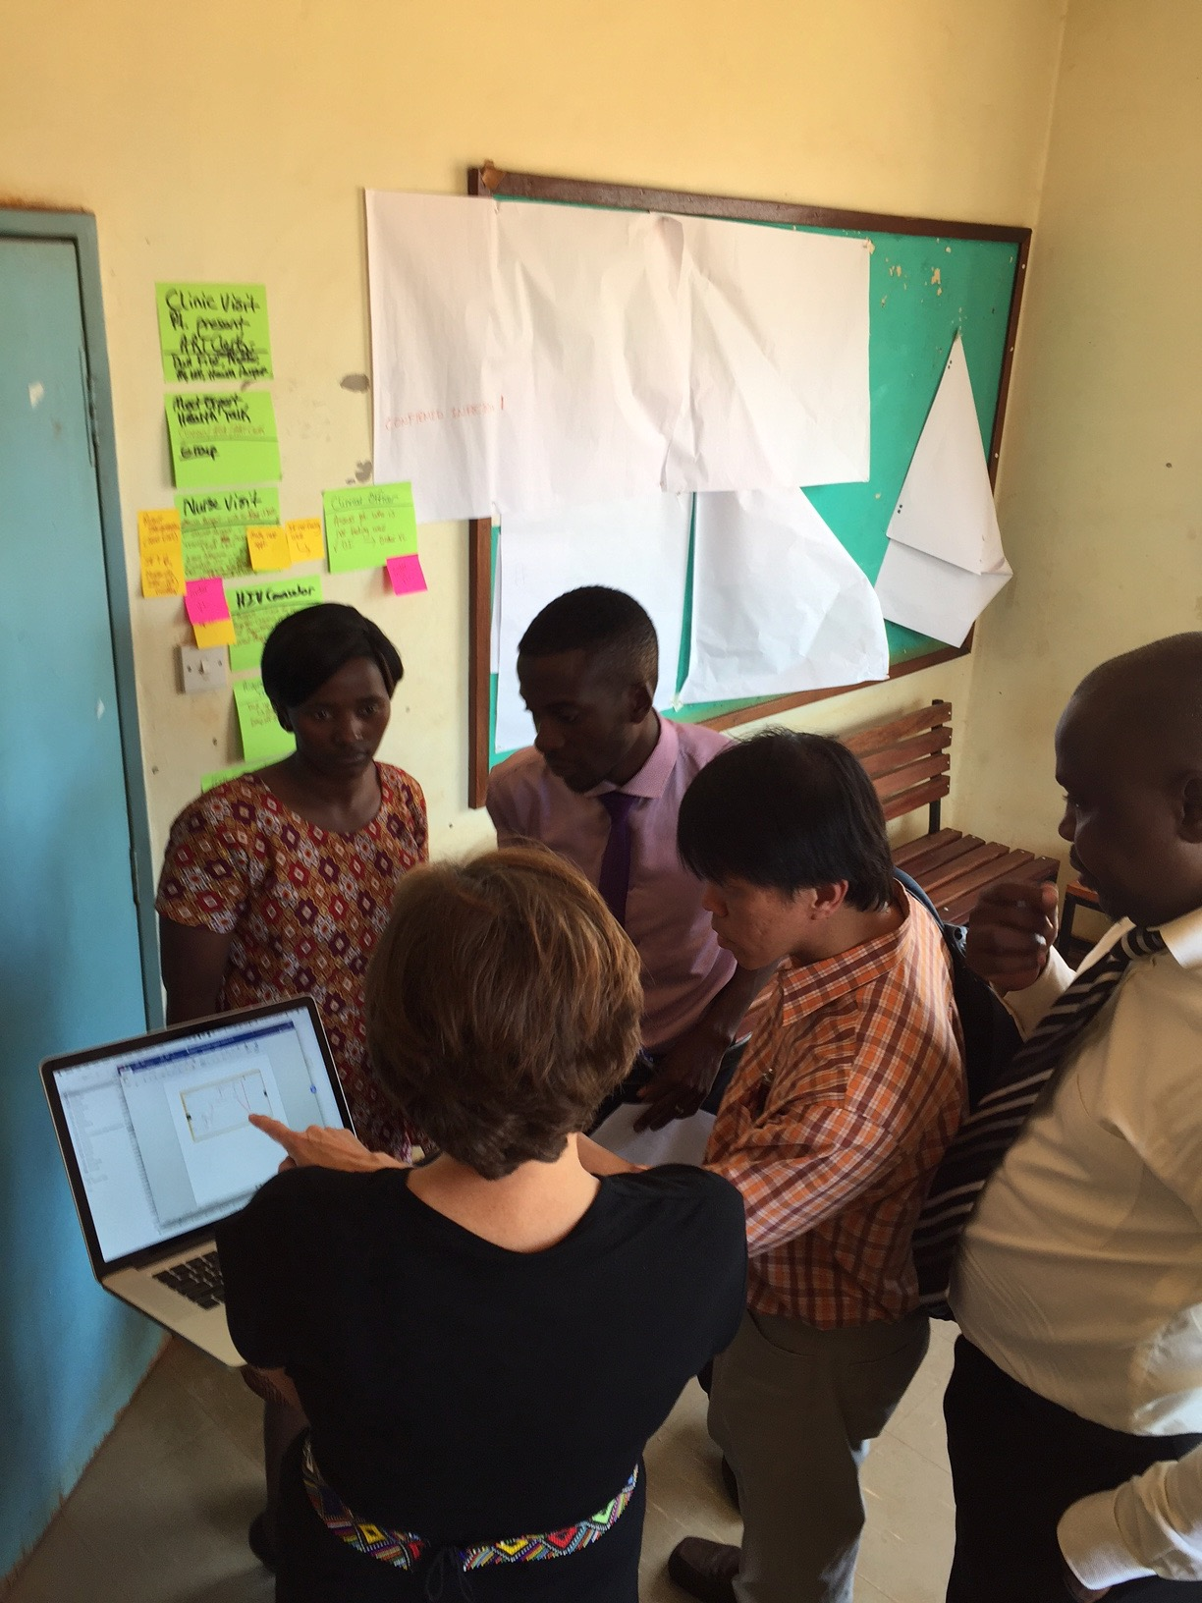
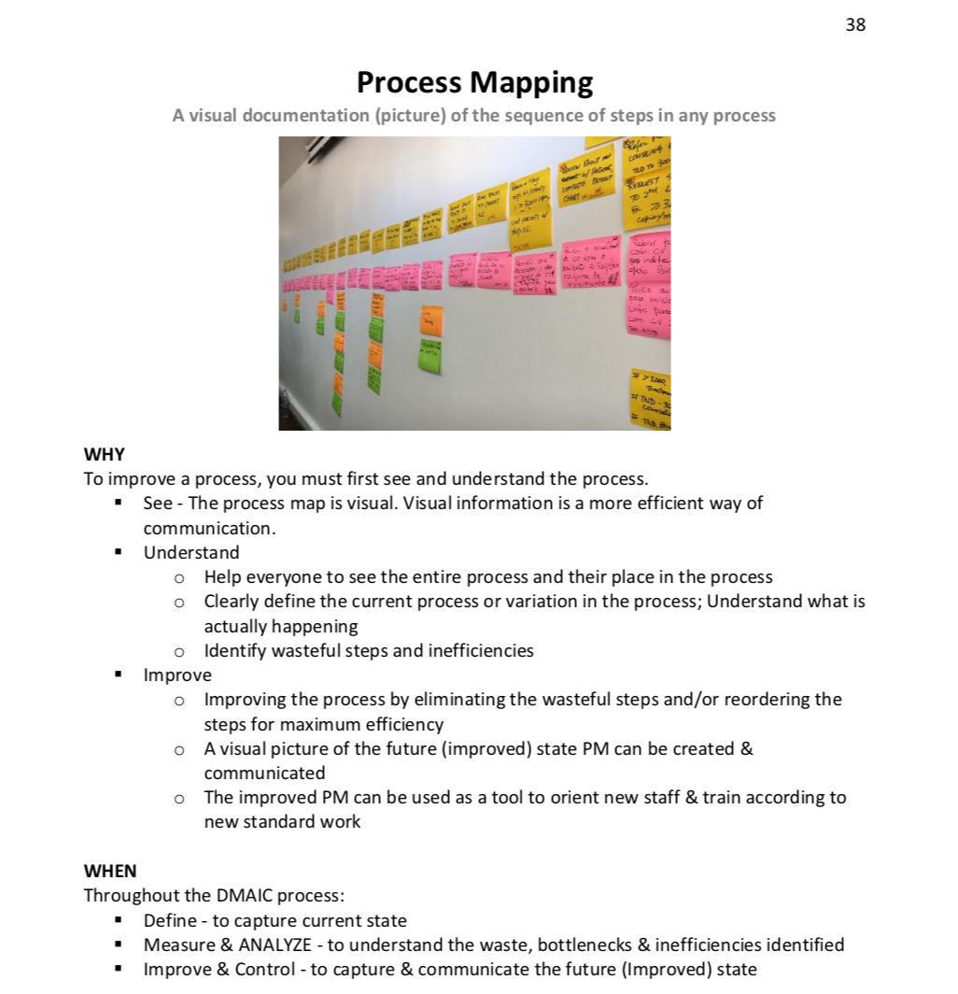
Focus on …
PROCESSES
Process Mapping
RESOURCE: WORKBOOK

Slide 41
Use…
DATA
“What gets measured, gets fixed.”

Slide 42
Riruta Health Centre
To reduce the number of missed appointments due for viral load test from 25% to 10% by March 2019
Embakasi Health Centre
To reduce % of missing viral load results in the viral load tracking log from 2% to 0% by March 2019
Thika L5 Hospital
To increase % of hardcopy viral load results placed in patient files from 0 % to 90% by March 2019
Due to result delays, 100% results were missing in last 2 periods (not shown here)
Delay of results due to reagent shortage
Maragua Sub County Hospital
To increase the % of HVL results documented in the green cards in patients’ files from 23% to 80% by March 2019
Baraka Dispensary
To decrease % of patients with HVL not attending EAC within 30 days of receiving results from 48% to 10% by March 2019
Relentless focus on results

Slide 43



Use…
TEAMS
Multidisciplinary Teams

Slide 44
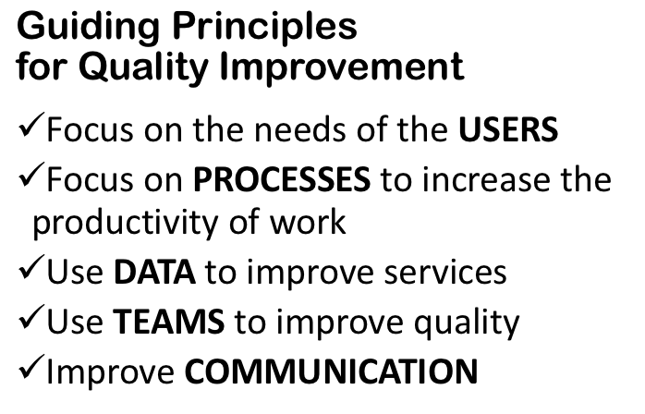
STOP & SUMMARIZE
CHANGE
LEARNING

Slide 45
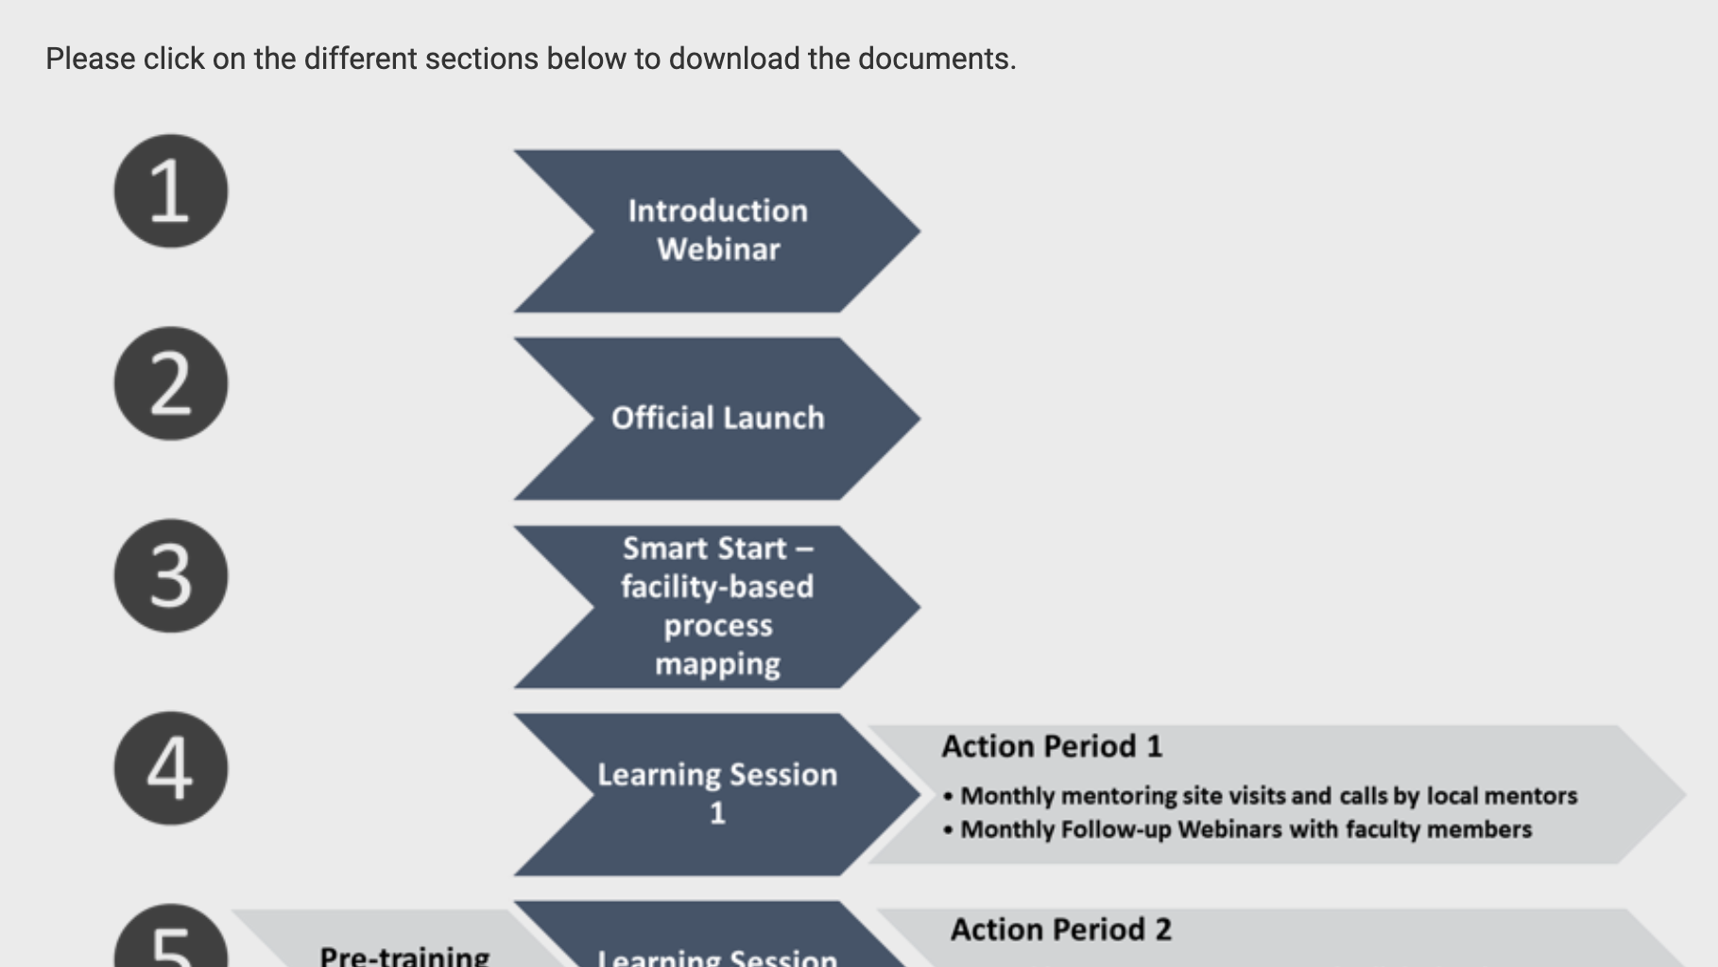
larccqi.org

Slide 46

larccqi.org

Slide 47


Slide 48
Quality Improvement Collaborative
Thank You
LARC
LARC

Slide 49
Preparation for the LARC Initiative
LARC
Implementers
Stakeholders
Coaches / Mentors
Facility Teams

Slide 50
Implementers
Stakeholders
Coaches / Mentors
Facility Teams

Slide 51
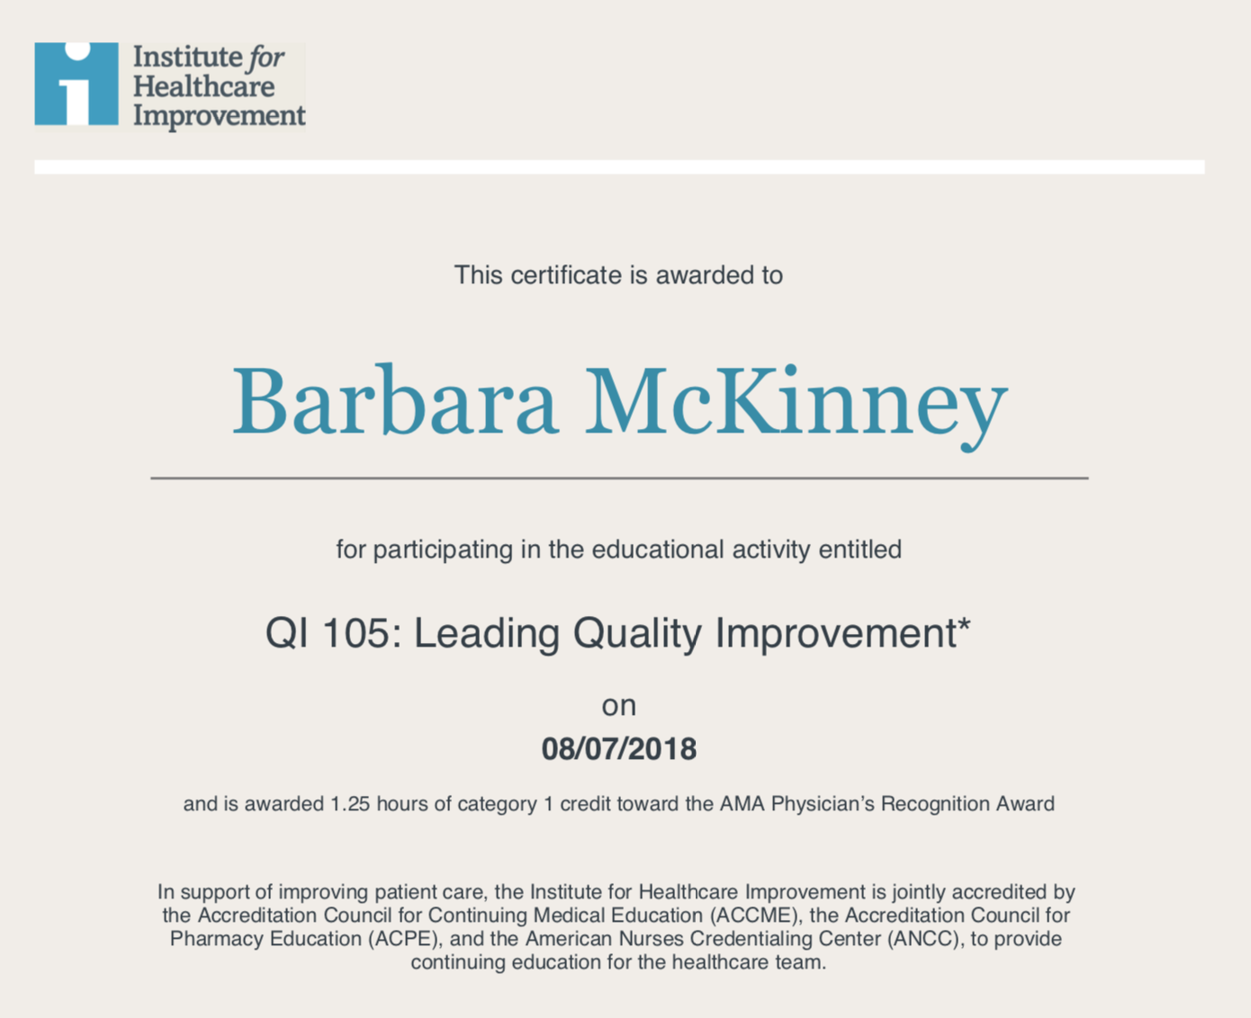
Prerequisites
IHI Open School
7 Courses
CEUs
larccqi.org

Slide 52
MOH and
Implementing Partners

Slide 53
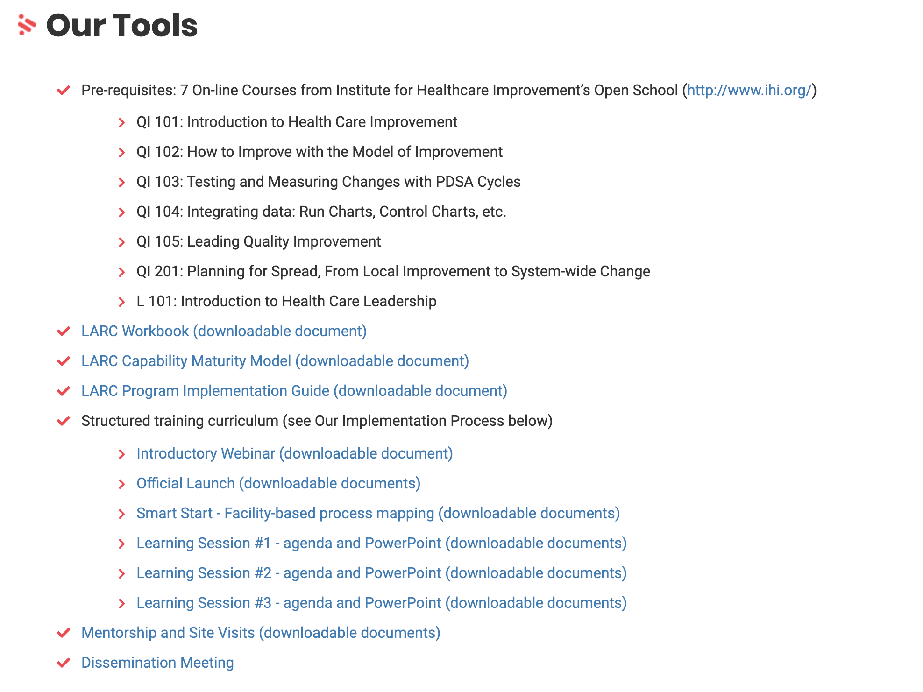
LARC
Implementation Guide
larccqi.org

Slide 54
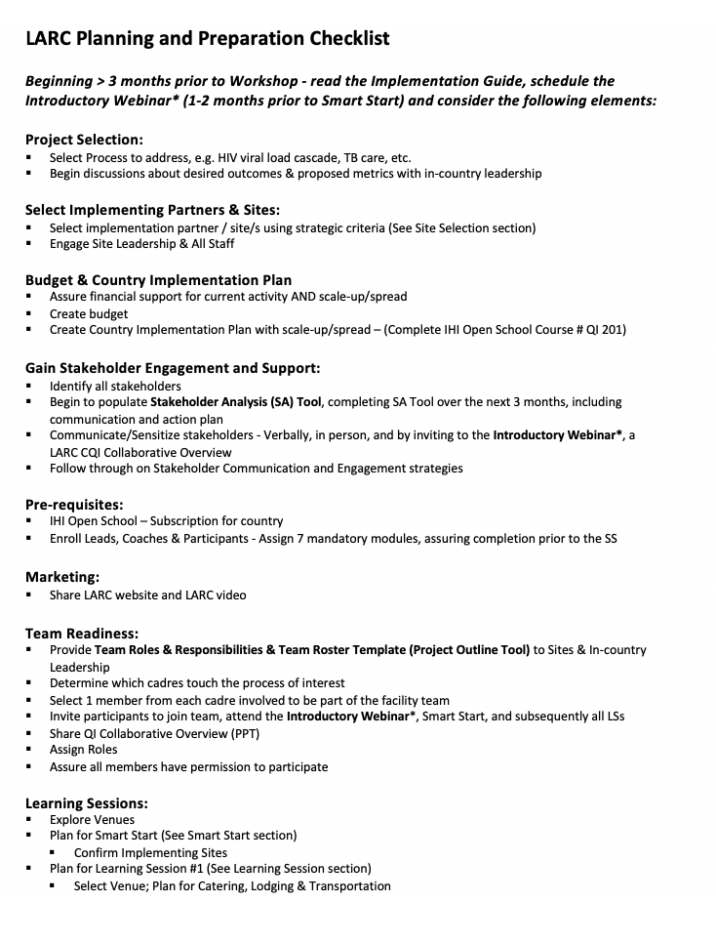

LARC Planning & Preparation Checklist
Step-by-Step Planning
Planning Checklist
Implementation Guide, p. 6
Notes:
The planning & preparation are essential to a successful LARC implementation. This is new to LARC 2.0 and will require a significant amount of focus, commitment, time and resources – not to be taken lightly!

Slide 55
Coaches / Mentors

Slide 56
Coaches / Mentors:
Roles & Responsibilities
Learning Sessions
Site Visits
Assist facility teams to:
Learn & utilize CQI tools
Complete project successfully

Slide 57
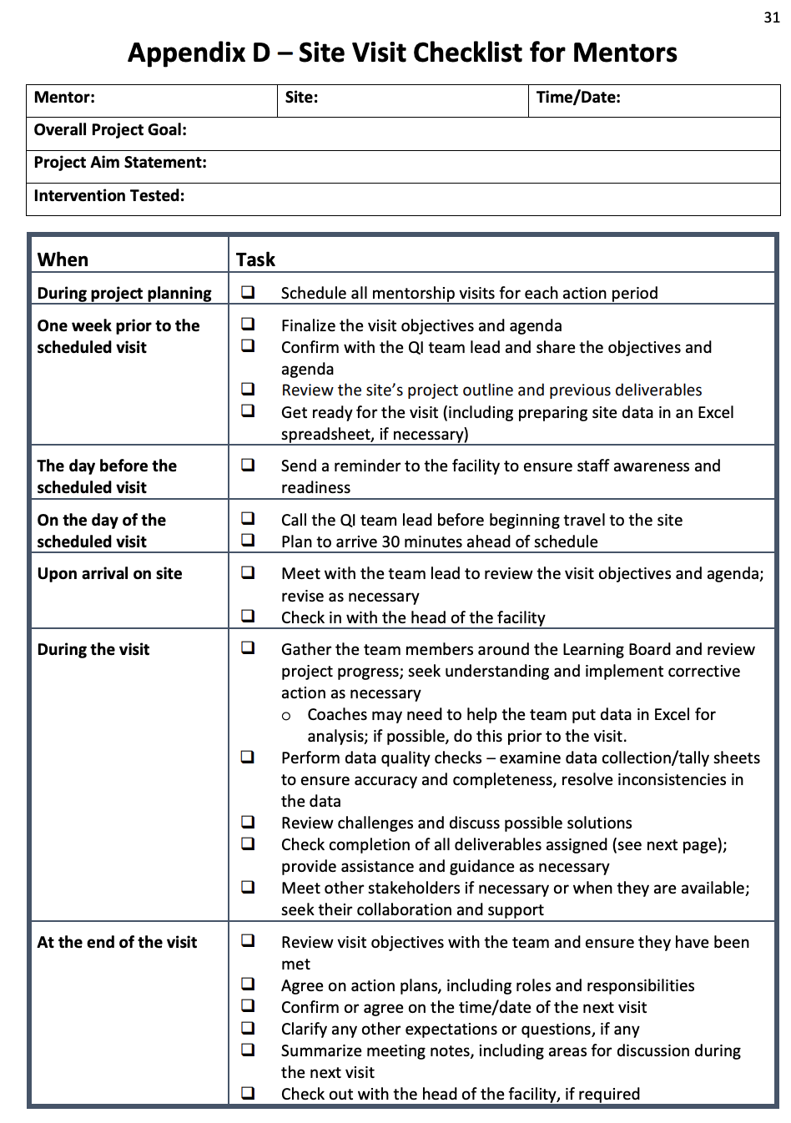
Coaches / Mentors:
Roles & Responsibilities
Learning Sessions
Site Visits
Implementation Guide, p. 31

Slide 58
Coaching Network =
Learning Network
LARC FACULTY
COACH D
COACH C
COACH B
COACH A
Monthly Calls
  Project Updates
  Successes
  Challenges

Slide 59
Facility Teams
Two Assignments prior to Smart Start

Slide 60
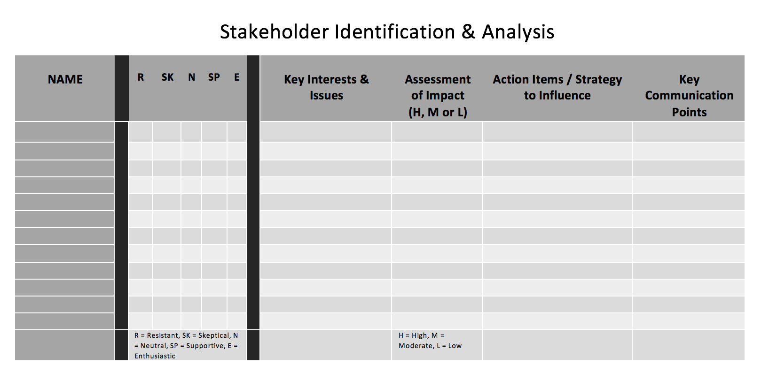
Stakeholder Analysis
Workbook, p. 34-37

Slide 61
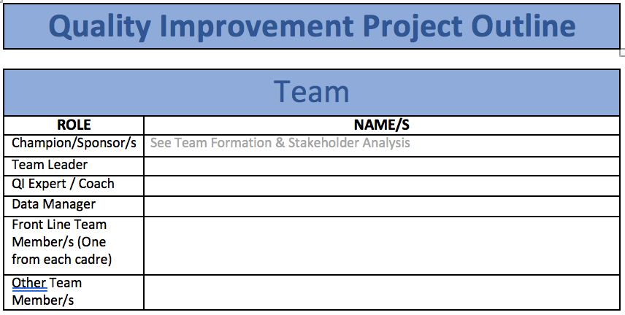
Team Formation
Workbook, p. 30-33
Workbook, p. 42

Slide 62

Team Formation
Team Members → 1 Person from each cadre that touches the process
A Typical Team:
Physician or Clinician
Nurse
Laboratorian
Counselor
Data Clerk
Expert Client / Peer Educator

Slide 63
STOP & SUMMARIZE
IHI COURSES
IHI Open School
7 Courses
STAKEHOLDER ANALYSIS
LARC FACULTY
COACH D
COACH C
COACH B
COACH A
COACHING NETWORK
IMPLEMENTATION GUIDE
TEAM FORMATION

Slide 64
Preparation for Smart Start:
The 2-Day On-Site Session
For Coaches

Slide 65
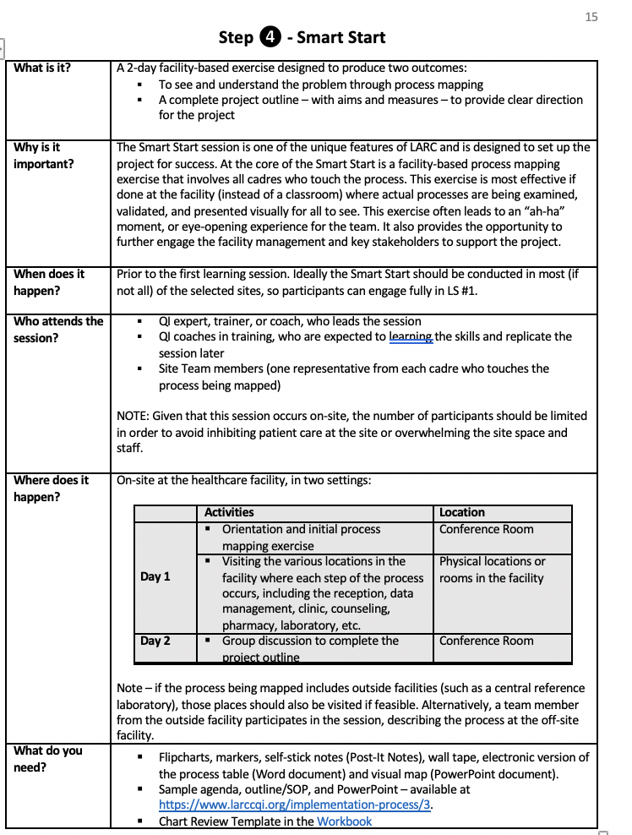
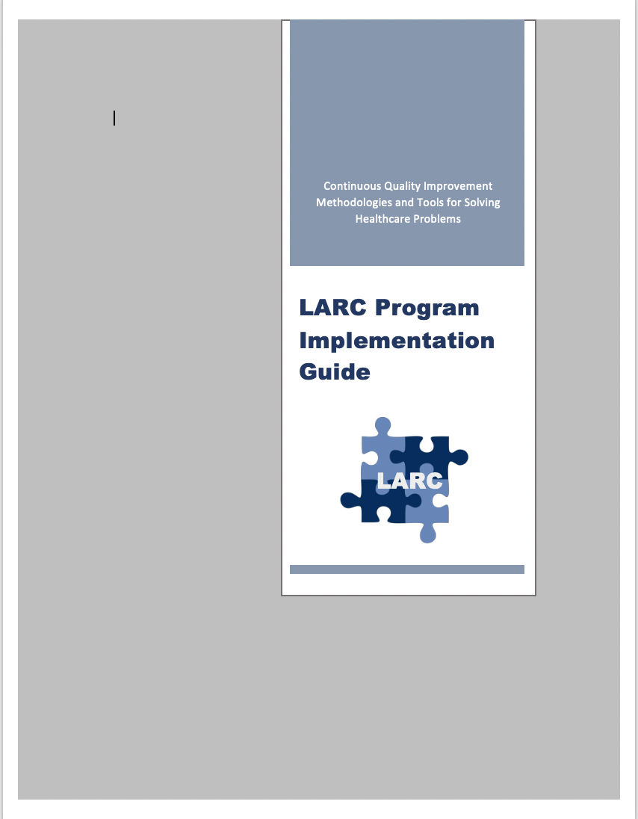
Implementation Guide
larccqi.org

Slide 66
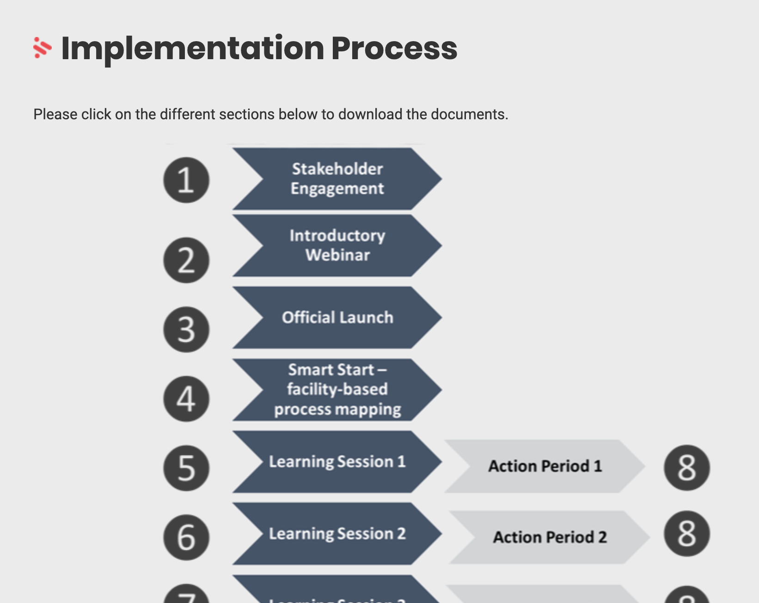
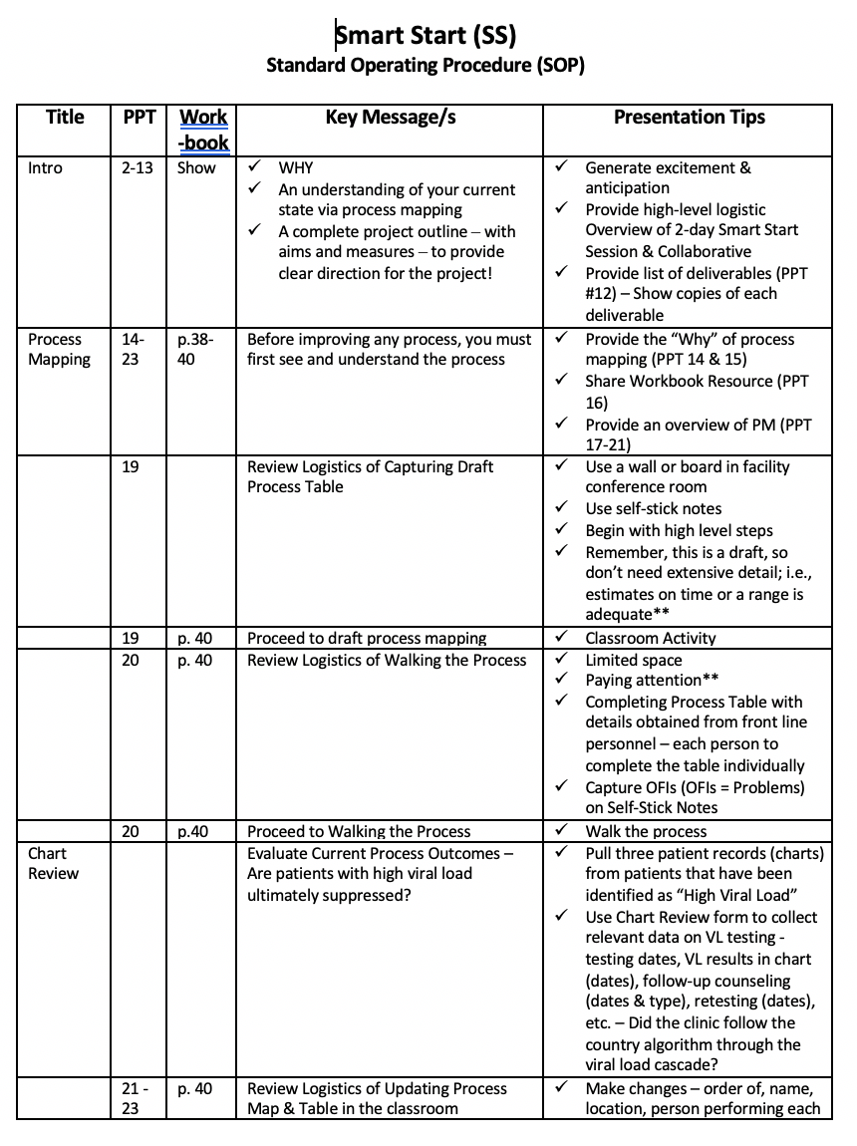
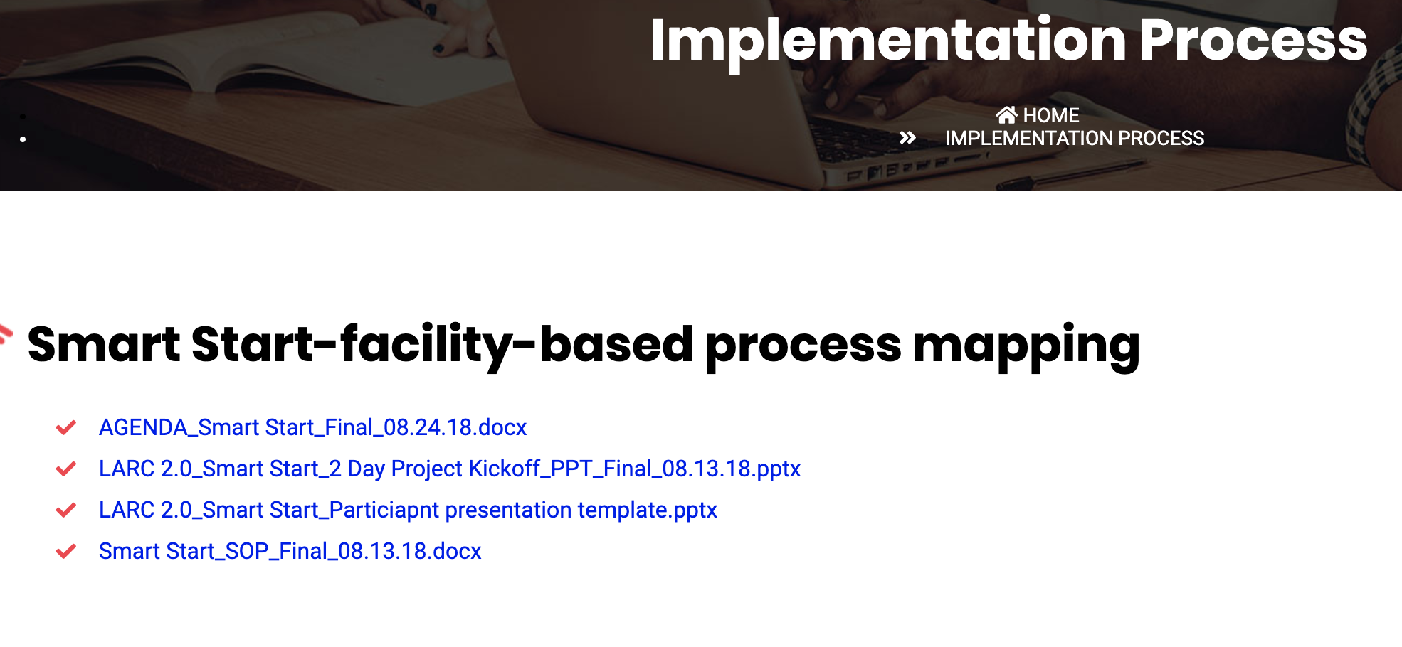
larccqi.org

Slide 67
LARC
Capability Maturity Model (CMM)

Slide 68
LARC Program Goals
To strengthen the viral load cascade to achieve better patient result (i.e., viral load suppression)
To improve institutional capability for viral load scale-up
Program Goals | Measures
Did the changes implemented at each site improve service delivery? | Facility-specific aims and metrics
Was the institutional capability for viral load scale-up enhanced? | Capability Maturity Model (CMM)

Slide 69
Capability Maturity Model
Developed by Carnegie-Mellon University Software Engineering Institute (1987)
Introduced a process for assessing software capability through a structured, sequential manner
Described the maturation of each function according to a linear scale of increasing capability
Can be adapted to evaluate an organization (or regional initiative) capability

Slide 70
CMM Stages
Optimized – Focus on process
improvement
Stage 5
Measured – Processes are measured and controlled
Stage 4
Stage 3
Defined – Processes are defined and standardized for the organization
Stage 2
Managed – Processes are dependent on individuals and are not standardized
Stage1
Initial - Processes are not repeatable, poorly controlled, and reactive

Slide 71
Organizational Assessment with CMM
Establish core functions in which capability is required
  Based on the organizational goals, identify the essential functions
Describe sequential stages of maturity of each function
  Progression is step-wise and linear
  Characteristics that define each maturational stage
  Progress from one stage to the next reflects a meaningful improvement in a key function
  Sets a clear path of achieving maturational goals

Slide 72
The LARC CMM tool covers 5 of the 6 phases in the viral load cascade.
Demand Creation for Testing
Specimen Collection and Processing
Sample Transport
Laboratory Testing
Result Reporting
Result interpretation & Client Management
Viral Load Cascade
CMM
CMM
CMM
CMM
CMM
Lab-Clinic Interface
Lab-Clinic Interface

Slide 73
Demand Creation for Testing
Stage 1 | Stage 2 | Stage 3 | Stage 4 | Stage 5
Clinicians unaware of access to viral load testing and have not been educated on its role in ART monitoring Community leaders/CSOs unaware of access to viral load testing and have not been educated on its role in ART monitoring Clients unaware of access to viral load testing and have not been educated on its role in ART monitoring No standard operating procedures for viral load testing and education | Increased awareness of VL testing in clinicians, however minimal information is shared with clients Clinicians occasionally order viral load testing for clients Community leaders /CSOs have an increased awareness of viral load testing and its role in ART monitoring Clients have an increased awareness of viral load testing and its role in ART monitoring Standard operating procedures for viral load testing and education are in development | Clinicians routinely educate clients about viral load testing and its benefits Clinicians routinely order viral load testing in- line with national guidelines Community leaders /CSOs play an active role in educating their community about knowing their viral load status Clients are aware of and actively seek viral load testing Viral load testing and education standard operating procedures are established and implemented across the organization | Organization reviews routinely collected program data to measure performance in relation to standard operating procedures and national guidelines for clinician use of viral load testing and education of clients All stakeholders (e.g., clinicians, client groups, community leaders, etc.) play active role in community education about VL testing and promote campaigns for all individuals to know their VL | □ Organization uses rigorous evaluation procedures and findings to demonstrate effectiveness and improve the process of demand creation for viral load testing

Slide 74
Specimen Collection and Processing
Stage 1 | Stage 2 | Stage 3 | Stage 4 | Stage 5
No client access to viral load testing /specimen collection No standard supply chain system for specimen collection commodities (e.g., DBS bundles) so supplies limit ability to collect specimens Clinicians/personnel not trained to complete specimen requisition forms No standard operating procedures for appropriate viral load specimen collection and preparation | Viral load specimens are collected occasionally and only on certain days, limiting client access to testing and increasing burden for clients to return for VL sample collection Increased capacity for supply chain system for specimen collection commodities, however not standardized Increased awareness in clinicians/personnel for properly completing requisition forms Standard operating procedures for appropriate viral load specimen collection and preparation are in development | Viral load specimens are collected routinely with few barriers for clients Standardized supply chain system for specimen collection commodities Clinicians/personnel complete specimen requisition forms accurately and completely Viral load specimen collection and preparation standard operating procedures are established and implemented across the organization | Organization reviews routinely collected program data to measure performance in relation to standard operating procedures and national guidelines for specimen and collection preparation All stakeholders (e.g., clinicians, personnel, clients, etc.) play active role in appropriate viral load specimen collection and preparation to facilitate clients to know their VL | □ Organization uses rigorous evaluation procedures and findings to demonstrate effectiveness and improve the process of specimen collection and preparation

Slide 75
Laboratory Testing
Stage 1 | Stage 2 | Stage 3 | Stage 4 | Stage 5
Inadequate lab infrastructure for viral load testing (i.e. space/storage/ equipment/reagents/kits for viral load testing) Laboratory staff are not properly trained nor competent to test viral load specimens Laboratory has little or no capacity for viral load testing No standard operating procedures or competency standards for laboratory viral load testing | Improved laboratory infrastructure, however, laboratory is only able to receive and test viral load specimens occasionally or must refer to another laboratory Laboratory staff are trained, however, competencies are minimal Laboratory is has minimal capacity and viral load testing is occasionally completed in a timely manner Standard operating procedures and competency standards for laboratory viral load testing are in development | Laboratory is able to regularly receive and test viral load specimens in timely manner Laboratory has appropriately trained and competent staff Laboratory is working at capacity and viral load testing is completed in a timely manner Laboratory viral load testing standard operating procedures and competency standards are established and implemented across the organization | □ Organization reviews routinely collected program data to measure performance in relation to standard operating procedures and national guidelines for viral load specimen testing | □ Organization uses rigorous evaluation procedures and findings to demonstrate effectiveness and improve the process of laboratory viral load specimen testing

Slide 76
Results Reporting
Stage 1 | Stage 2 | Stage 3 | Stage 4 | Stage 5
Results are not received in a timely manner at the clinic from the laboratory Results are not recorded in the client’s chart in a timely manner No standard operating procedures for results reporting and documenting results in the client’s chart | Results are occasionally received in a timely manner by the clinic from the laboratory Results are occasionally recorded in the client’s chart in a timely manner but often not returned to clients Standard operating procedures for results reporting and documenting results in the client’s chart are in development | Results are regularly received by the clinic in a timely manner from the laboratory Results are regularly recorded in the client’s chart in a timely manner and returned to the client regularly Results reporting and chart documentation standard operating procedures are established and implemented across the organization | Organization reviews routinely collected program data to measure performance in relation to standard operating procedures and national guidelines for results reporting Clinic ensures a facility-based person is accountable for timely recording of VL results in client charts and notification of clients with VL>1000 to return to clinic prior to scheduled appointment | □ Organization uses rigorous evaluation procedures and findings to demonstrate effectiveness and improve the process for results reporting

Slide 77
Results Interpretation and Client Management
Stage 1 | Stage 2 | Stage 3 | Stage 4 | Stage 5
Viral load results are difficult to read and interpret and requires laboratory assistance Clinicians are not properly trained to interpret viral load results Clinicians are uncomfortable integrating viral load results into ART care Clients do not understand their viral load results Clinicians have no backup person to call to discuss difficult cases or clients who require 2nd line treatment No standard operating procedures for result interpretation and client management | Viral load results are occasionally readable and interpretable and requires minimal laboratory assistance Increased awareness of result interpretation by clinicians Few clinicians are comfortable integrating viral load results into ART care Clients have a limited understanding of their viral load results Intermittent availability of consultation for 2nd line treatment Standard operating procedures for result interpretation and client management are in development | Viral load results are consistently readable and interpretable by clinicians Clinicians are adequately trained in viral load result interpretation Clinicians regularly discuss VL results with clients Clients understand their viral load results and can repeat their understanding back to the clinician Standardized system in which all providers have a designated POC/referral system in place to consult for management of VL results and switch to 2nd line Result interpretation and client management standard operating procedures are established and implemented across the organization | Organization reviews routinely collected program data to measure performance in relation to standard operating procedures and national guidelines for client management All stakeholders (e.g., clinicians, personnel, clients, etc.) play active role in client management and their viral load Clinic has ability to identify missed opportunities for ensuring VL results are integrated with client management | □ Organization uses rigorous evaluation procedures and findings to demonstrate effectiveness and improve the process of client management

Slide 78
Quality Improvement Collaborative
Thank You
LARC
LARC

Slide 79
Questions
Thank You
??????????????????

